Slide 1
Pizza Sales Data Analysis using SQL Server
Project for Data Analyst
Tools: SQL Server, Excel
Goal: Extract business insights from sales data
Table: pizzas, pizza types, orders, orders details

Slide 2
Business Questions
Basic:
Retrieve the total number of orders placed.
Calculate the total revenue generated from pizza sales.
Identify the highest-priced pizza.
Identify the most common pizza size ordered.
List the top 5 most ordered pizza types along with their quantities.
Intermediate:
Join the necessary tables to find the total quantity of each pizza category ordered.
Determine the distribution of orders by hour of the day
.Join relevant tables to find the category-wise distribution of pizzas.
Group the orders by date and calculate the average number of pizzas ordered per day.
Determine the top 3 most ordered pizza types based on revenue.
Advanced:
Calculate the percentage contribution of each pizza type to total revenue.
Analyze the cumulative revenue generated over time.
Determine the top 3 most ordered pizza types based on revenue for each pizza category.

Slide 3
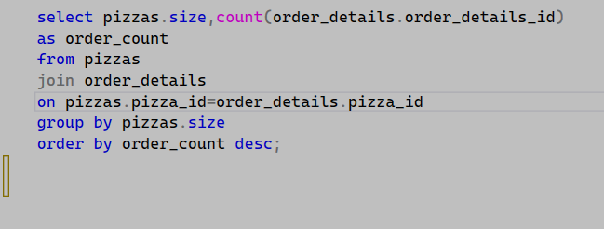
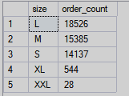
Identify the most common pizza size ordered.

Slide 4
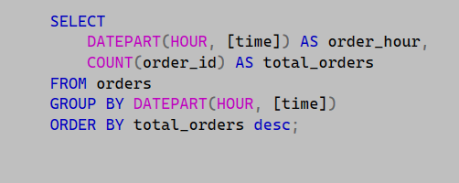
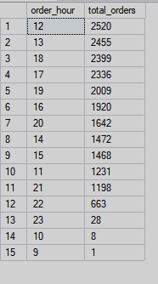
Determine the distribution of orders by hour of the day.

Slide 5
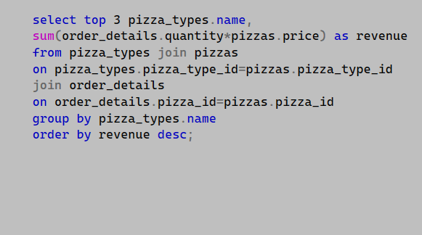
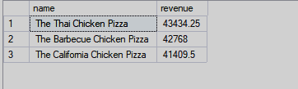
Determine the top 3 most ordered pizza types based on revenue.

Slide 6
🍕 Pizza Sales Data Analysis – Business Insights
I recently worked on a Pizza Sales Data Analysis Project to understand customer behavior, sales performance, and product demand using a real-world dataset. The goal of this project was to extract actionable business insights that could help a pizza business improve sales and optimize operations. Below are some of the key insights from the analysis.
Overall Business Performance
The dataset reveals strong sales performance with a high volume of customer orders.
Orders: 21,000+
Total Pizzas Sold: 49,000+
Total Revenue: $800K+
These numbers indicate a healthy demand for pizza products, with customers typically ordering 2–3 pizzas per order, suggesting group or family consumption.

Slide 7
Top-Selling Pizzas
The analysis highlights several pizzas that consistently drive sales.
Most Popular Pizzas
Classic Deluxe Pizza, Barbecue Chicken Pizza, Hawaiian Pizza, Pepperoni Pizza, Thai Chicken Pizza.
These products generate a large portion of total sales, showing that classic and chicken-based pizzas are highly preferred by customers.
Insight: Businesses should prioritize these pizzas in promotions, menu placement, and advertising campaigns.📏
Pizza Size Preferences :Customer demand varies significantly based on pizza size.
Sales Distribution by Size
Large (L) – Highest demand Medium
(M) – Second most popular Small
(S) – Moderate demand
XL / XXL – Very low demand
Insight: Large pizzas dominate sales, likely because they are ideal for group orders or family meals.
Business Opportunity : Offer family combo deals or discounts on large pizzas to increase order value.

Slide 8
Peak Sales Hours
Understanding customer ordering patterns is essential for business operations.
Most Busy Hours
12 PM – 1 PM (Lunch peak)
5 PM – 7 PM (Dinner peak)
These time slots experience the highest number of orders.
Insight: Restaurants should ensure adequate staffing and inventory during these hours to maintain service quality.🧑‍🍳
Customer Ordering Behavior
The analysis shows clear patterns in customer purchasing habits.
Key observations:
Customers prefer classic and well-known pizza flavors.
Orders usually include multiple pizzas, indicating group consumption.
Demand increases during meal times.
This suggests that the pizza business is largely driven by family meals, office orders, and social gatherings.

Slide 9
Business Recommendations
Based on the insights, several strategies could help improve revenue:
Promote best-selling pizzas through targeted marketing.
Introduce combo deals for large pizzas.
Optimize staffing during peak lunch and dinner hours.
Create limited-time offers on less popular pizza sizes to boost demand.🚀
Conclusion
This project demonstrates how data analysis can transform raw sales data into meaningful business insights. By understanding customer preferences, sales trends, and peak demand periods, businesses can make data-driven decisions to improve sles performance and customers satisfactions.

Slide 10
GitHub Repository
Your tehttps://github.com/siddharthbusiness123123-cmd/Pizzas-Sales-Analysis-using-SQL-Serverxt here

